Slide 1








Object Detection
 | Result | Output Level | Instant Detect | All Areas Output | Models
Image Classification |  | Image | ✖ | 〇 | VGG ResNet Inception MobileNet DenseNet
Image Classification Localization |  | Box | ✖ | ✖ | HOG BOF PASCAL VOC
Object Detection |  | Box | 〇 | ✖ | R-CNN Fast R-CNN SDD YOLO RetinaNet
Semantic Segmentation |  | Pixel | ✖ | 〇 | U-NET MULTISCALE HYBRID CNN-CRF
Instant Segmentation |  | Pixel | 〇 | ✖ | Mask R-CNN DeepMask FCIS
Panoptic Segmentation |  | Pixel | 〇 | 〇 | Panoptic Feature Pyramid Network UPSNet
Dog 98%
Dog 93%
Dog 93%
Dog 97%
https://jingwora.github.io/

Slide 2
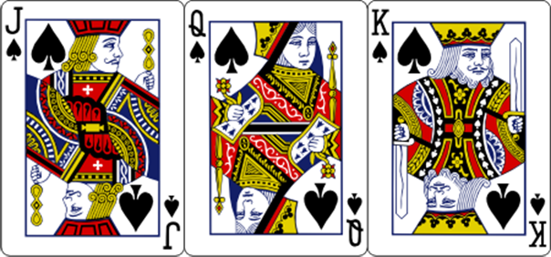


Slide 3
















PYSPARK
SKLEARN

Slide 4



Slide 5




Slide 6
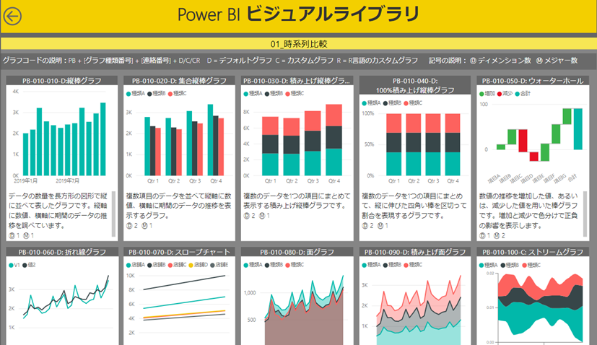
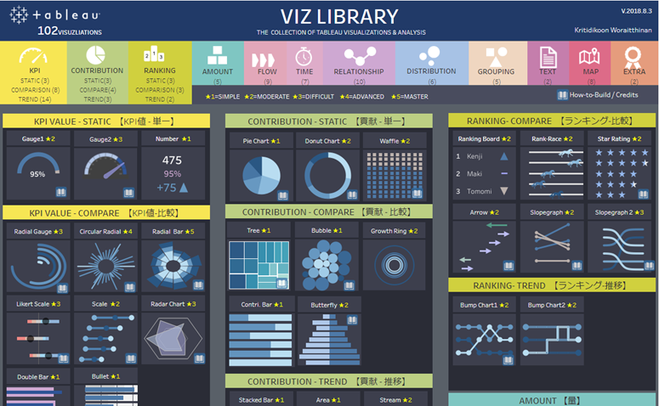
https://community.powerbi.com/t5/Data-Stories-Gallery/PowerBI-Visual-Library/td-p/998398

Slide 7





Slide 8














ENVIRONMENT
DEV
SERVER
USER
VS CODE
Colab
Tensorflow.js
Tensorflow.js
Local + Cloud
GitHub Pages: static site
AI at the Edge

Slide 9


Slide 10


Slide 11




Data Analysis
Data Science
Data Engineer
Web Developer

Slide 12
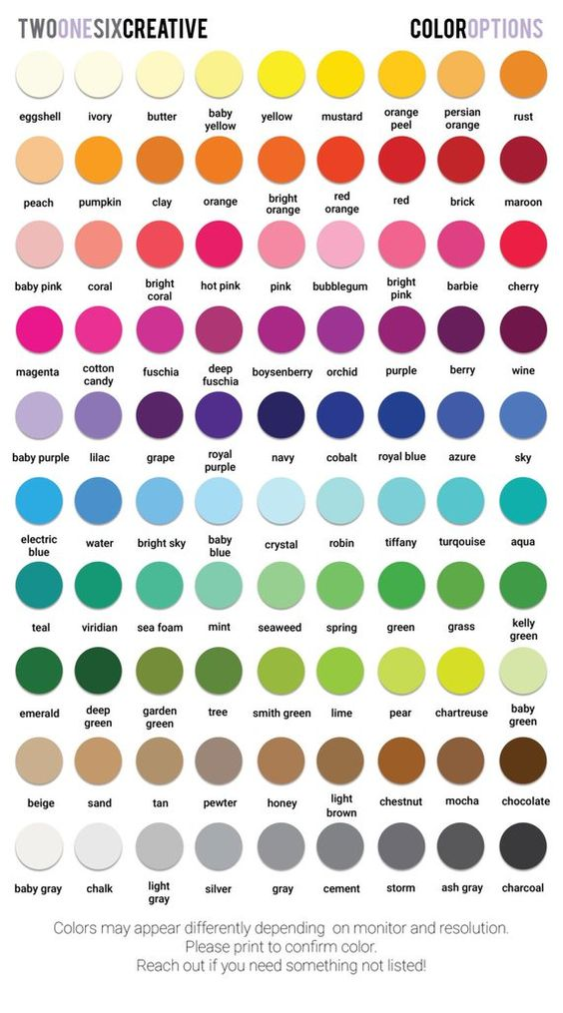
Total quality management (TQM)
4M Analysis Process
4M
 | Machine | Material | Man | Method
Plan
Actual
QA Status
 | Checking | Checked | Status | IQ
Line1
Line2
Line3
Line4
PPM
PPM
Claim
Defect

Slide 13

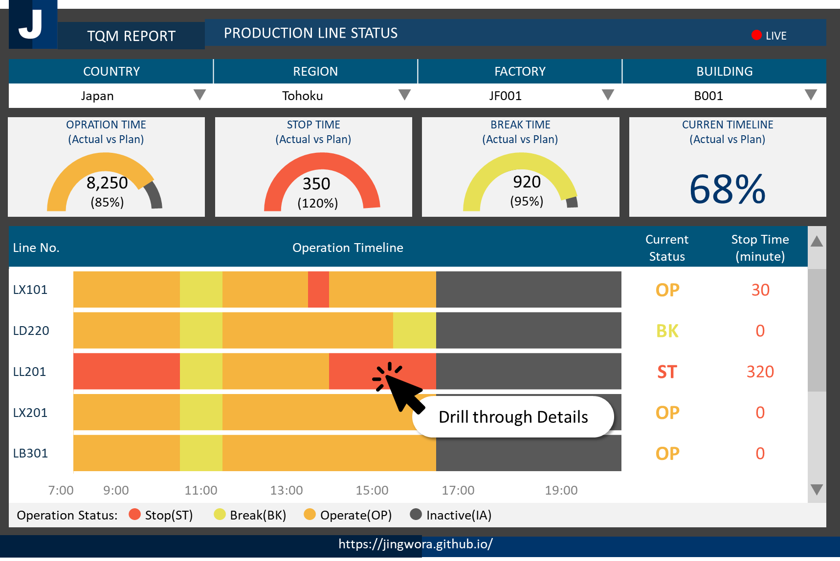

TQM REPORT
PRODUCTION LINE STATUS
● LIVE
COUNTRY |  | REGION |  | FACTORY |  | BUILDING
Japan | ▼ | Tohoku | ▼ | JF001 | ▼ | B001 | ▼
OPRATION TIME
(Actual vs Plan)
STOP TIME
(Actual vs Plan)
BREAK TIME
(Actual vs Plan)
CURREN TIMELINE
(Actual vs Plan)
68%
8,250
(85%)
350
(120%)
920
(95%)
Line No. | Operation Timeline |  |  |  |  |  |  |  |  |  |  |  |  |  |  |  |  |  |  |  |  |  |  |  | Current Status | Stop Time (minute) | ▲
LX101 |  |  |  |  |  |  |  |  |  |  |  |  |  |  |  |  |  |  |  |  |  |  |  |  | OP | 30
LD220 |  |  |  |  |  |  |  |  |  |  |  |  |  |  |  |  |  |  |  |  |  |  |  |  | BK | 0
LL201 |  |  |  |  |  |  |  |  |  |  |  |  |  |  |  |  |  |  |  |  |  |  |  |  | ST | 320
LX201 |  |  |  |  |  |  |  |  |  |  |  |  |  |  |  |  |  |  |  |  |  |  |  |  | OP | 0
LB301 |  |  |  |  |  |  |  |  |  |  |  |  |  |  |  |  |  |  |  |  |  |  |  |  | OP | 0
7:00 | 9:00 |  |  |  | 11:00 |  |  |  | 13:00 |  |  |  | 15:00 |  |  |  | 17:00 |  |  |  | 19:00 |  |  |  |  |  | ▼
Drill through Details
Operation Status: ● Stop(ST) ● Break(BK) ● Operate(OP) ● Inactive(IA)
https://jingwora.github.io/

